Slide 1
Digital Portfolio
STUDENT NAME: MERCY Y
REGISTER NO AND NMID: 2422J1012 AND 8A1CA0F9C00939A90B4468E59EC8C8EF
DEPARTMENT: BCA
COLLEGE: Akshaya college of arts and science / Bharathiyar University

Slide 2
PROJECT TITLE
LumiFolio – A Glow-Inspired Portfolio

Slide 3


AGENDA
Problem Statement
Project Overview
End Users
Tools and Technologies
Portfolio design and Layout
Features and Functionality
Results and Screenshots
Conclusion
Github Link
3/21/2024 Annual Review

Slide 4

PROBLEM STATEMENT
A lot of portfolios today look either too plain or too cluttered. Students and professionals often struggle to stand out with traditional resumes or basic portfolio designs. What’s missing is a modern, visually striking yet professional platform that catches attention instantly. A glowing, futuristic theme can solve this problem by making portfolios engaging, memorable, and interactive.

Slide 5

PROJECT OVERVIEW
LumiFolio is a futuristic digital portfolio website built with HTML, CSS, and JavaScript. It’s designed with a dark background and neon glow effects, giving it a modern and stylish vibe. The goal is to create a portfolio that not only looks professional but also feels unique and immersive, helping individuals showcase their skills and projects in a way that truly stands out

Slide 6

WHO ARE THE END USERS?
🎓 Students – to present academic projects in an eye-catching format
💼 Job Seekers – to impress recruiters with a fresh, modern portfolio
🎨 Designers & Creators – to showcase artwork or designs with a glowing aesthetic
👨‍💻 Developers – to highlight coding projects in a futuristic interface

Slide 7

TOOLS AND TECHNIQUES
Frontend: HTML5, CSS3, JavaScript
Editor: Visual Studio Code
Hosting: GitHub Pages or Netlify
Design Style: Dark theme + neon glowing accents, smooth animations,interactive hover effects

Slide 8
POTFOLIO DESIGN AND LAYOUT
🌌 Header – Glow-text logo with animated gradient background
🧭 Navigation Bar – Glowing buttons with hover highlights
🏠 Home Section – Welcome message with neon text effects
👤 About Section – Profile card with glowing borders and a bio
📂 Projects Section – Interactive glowing cards that highlight project details on hover
📞 Contact Section – Simple glowing icons for GitHub, Email, and LinkedIn
📌 Footer – Minimal glowing line with copyright
‹#›

Slide 9
FEATURES AND FUNCTIONALITY
✨ Neon glow hover animations that make the site interactive
🚀 Smooth navigation between sections using JavaScript
📂 Organized project cards with glowing effects
📱 Responsive design that works on mobile, tablet, and desktop
🎨 Dark futuristic theme that makes skills and projects stand out

Slide 10

RESULTS AND SCREENSHOTS
✅ A portfolio with a futuristic glowing theme was successfully created
✅ Projects are displayed with hover animations for better interaction
✅ Responsive design tested on desktop and mobile
✅ Balanced between creativity and professionalism
3/21/2024 Annual Review
‹#›

Slide 11
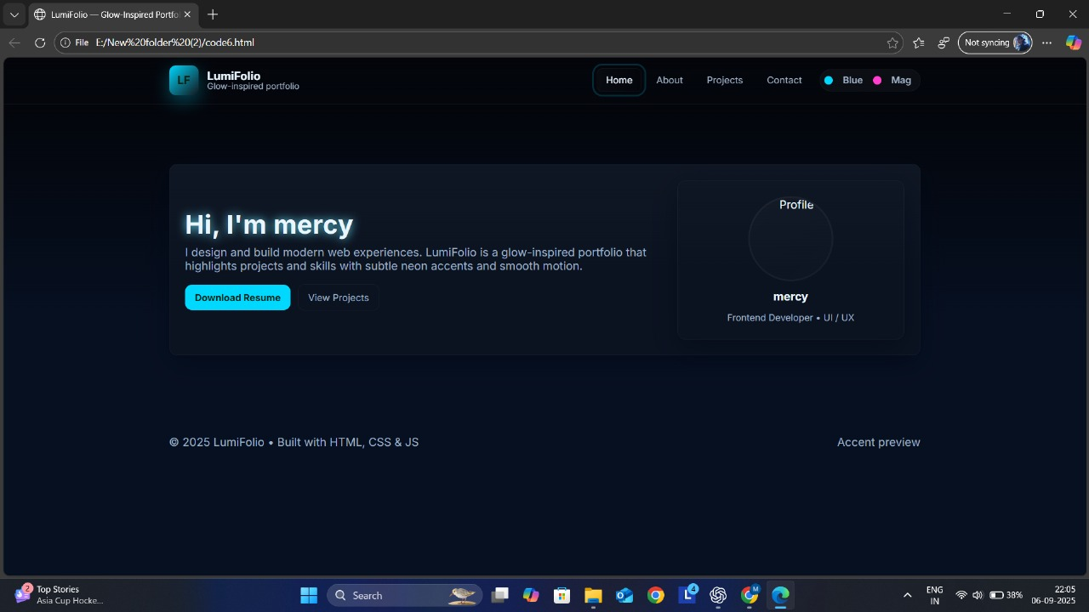

Slide 12
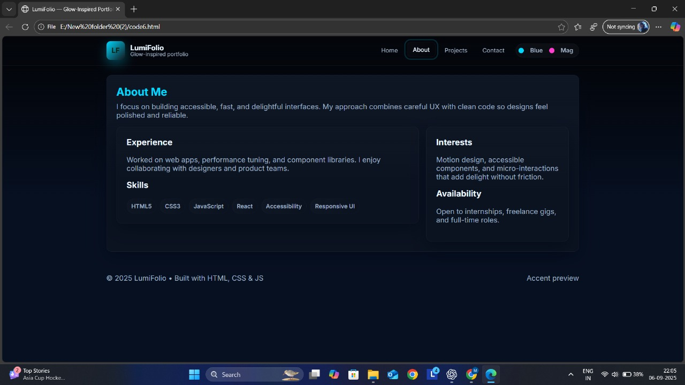

Slide 13
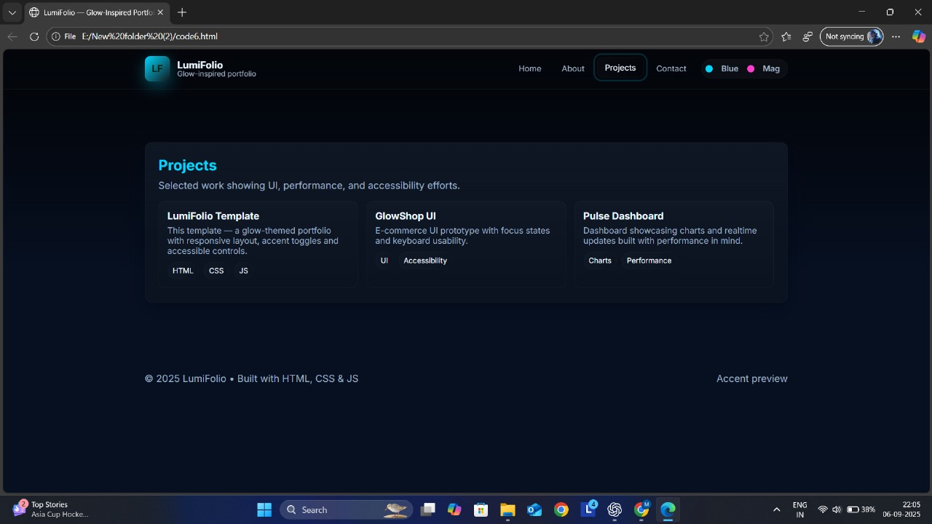

Slide 14
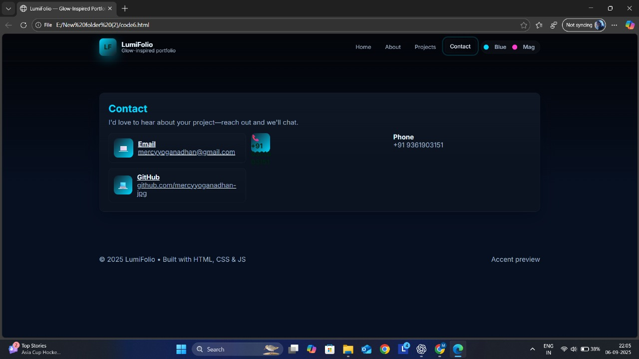

Slide 15
CONCLUSION
The LumiFolio project provides a modern way to showcase skills and achievements. By combining neon glow effects with a clean layout, it makes portfolios not just a digital resume, but an experience. This design helps students, job seekers, and professionals create a strong first impression and stand out in today’s digital-first world.
‹#›

